Slide 1
Tableau Project
.

Slide 2
/
1.Connect the sample superstore dataset to Tableau and select the “Order” sheet.
Create an area chart in Tableau for Sales.
Create an area chart to show sales year wise and month wise.
Apply filter to order date field and show it for all.
Rename it as 'Sales Area Chart'.
Colour your visual.

Slide 3
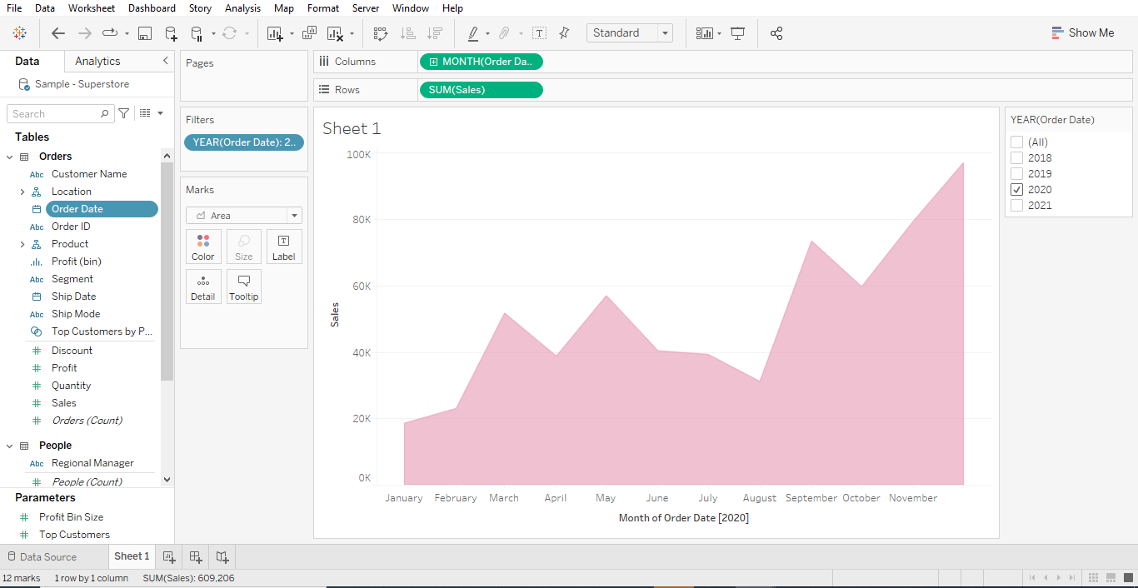

Slide 4
.
3.Create an area chart in Tableau for Profit.
Create an area chart to show profit year wise and month wise.
Apply filter to order date field and show it for all.
Rename it as 'Profit Area Chart'.
Colour your visual.

Slide 5
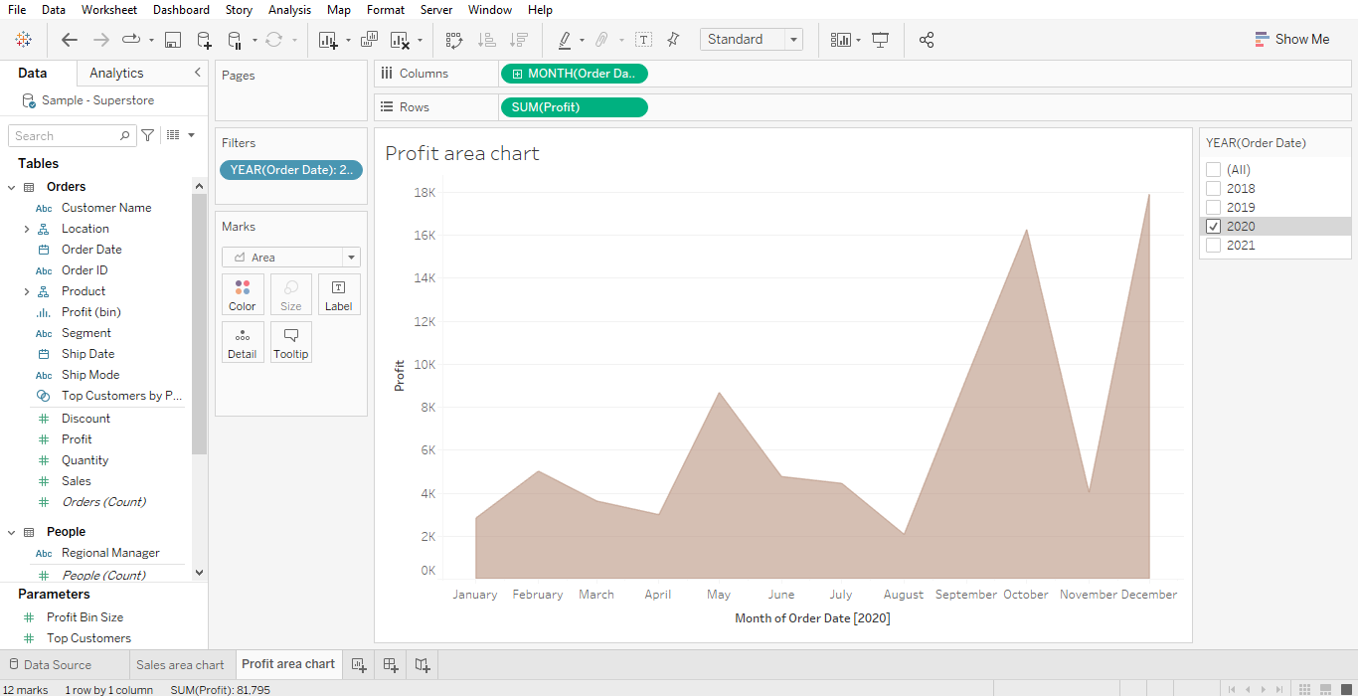

Slide 6
Create a Dashboard in Tableau and present both the sheets(Sales area chart & Profit area chart).
Remove one of the 'order of date' filter to vacate the space.
Make the slider for 'order of date' filter.
Make the slider applicable for both the visual.
Resize your dashboard to 1200 X 750 and rename your dashboard.
Make the dashboard interactive in such a way that when profit area chart is clicked then sales area chart should also update accordingly.
Publish your dashboard and share the link.

Slide 7
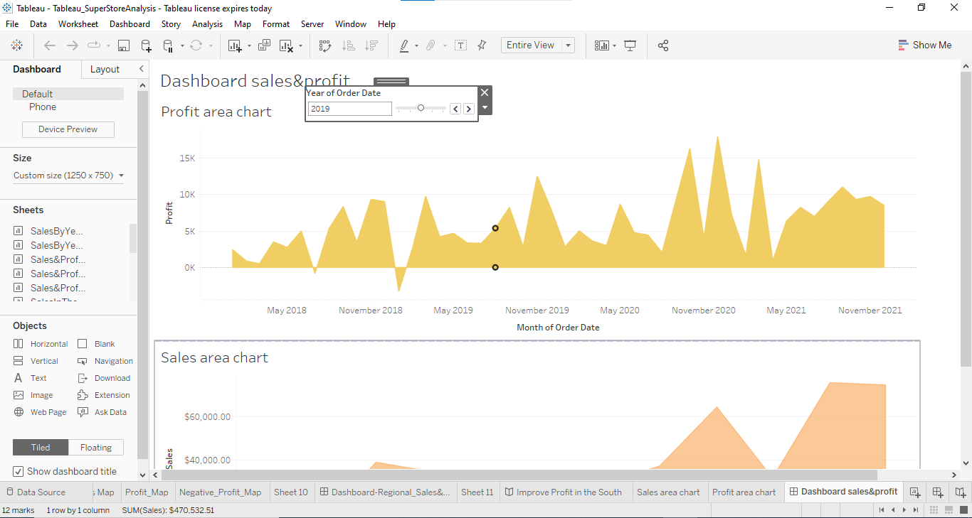

Slide 8
/
https://public.tableau.com/views/SuperStoreAnalysis_16458631652540/Dashboardsalesprofit?:language=en-US&publish=yes&:display_count=n&:origin=viz_share_link

